Slide 1
CLMT5053 Computing and Research Methods for Climate Data Science
Instructor
Prof. Dan Westervelt (danielmw@ldeo.columbia.edu)
TA:
Shweta Smriti Tripathi (sst2166@columbia.edu)
Jaewon Cho (jc6618@Columbia.edu)
Meeting time
Tuesday 1:10 – 3:40pm
Office hours
Instructor: by appointment
TA (Shweta):
TA (Jaewon):

Slide 2
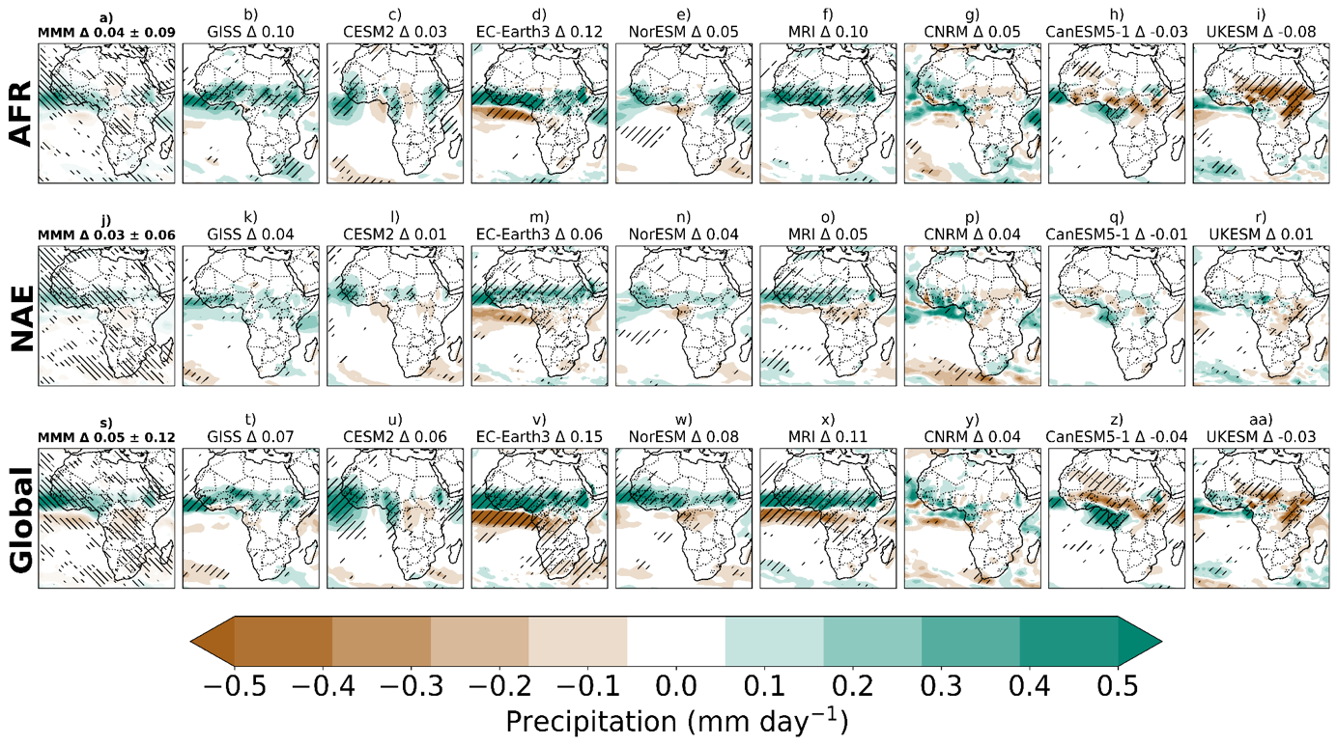
My research
Atmospheric modeling, climate change, air quality, atmospheric chemistry, air quality sensors
https://aerosol.ldeo.columbia.edu/
Precipitation response to changing aerosol emissions in 8 CMIP6 Climate Models

Slide 3
Visualization of 1 year simulation of chemistry-climate model
Courtesy of NASA

Slide 4
Challenges in research computing
Complexity
Our research goals are complex! How much coding do we need to know?
Solution: use the best tools for the job
Reproducibility
It’s not easy to reproduce the work of others (or even our own), which slows down scientific progress
Solution: embrace open-science practices
Data Size
It’s hard to work with terabytes of data
Solution: learn how to use high-performance computing

Slide 5
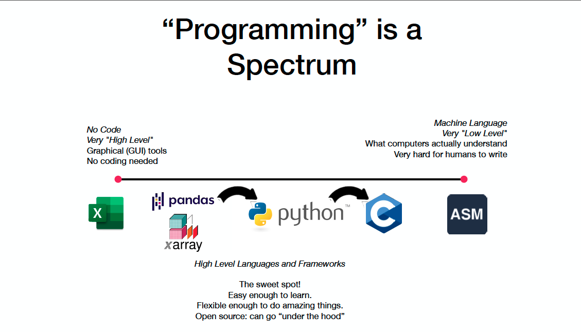
The tools

Slide 6
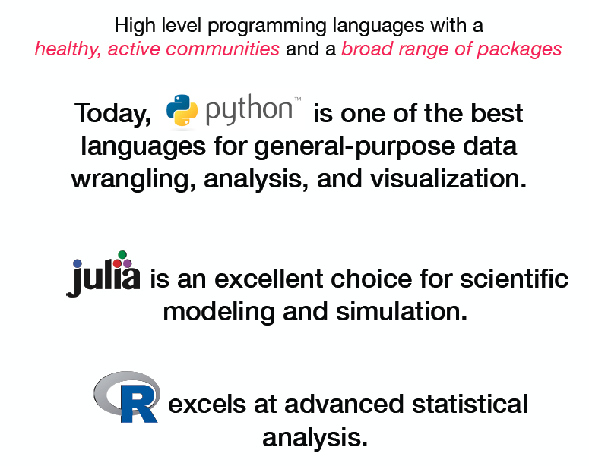
The tools

Slide 7
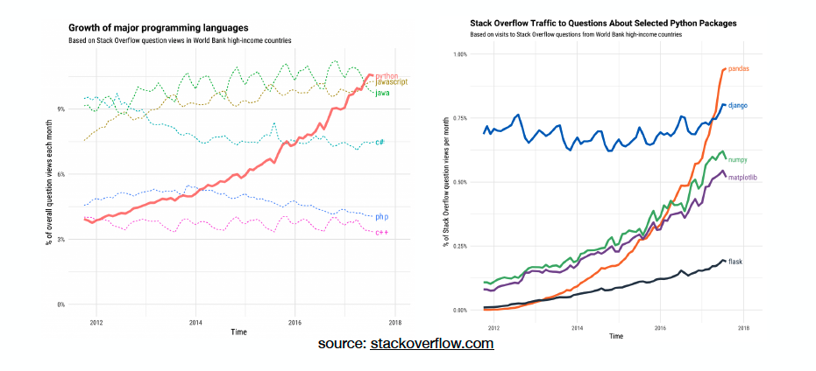
Popularity of various toools

Slide 8
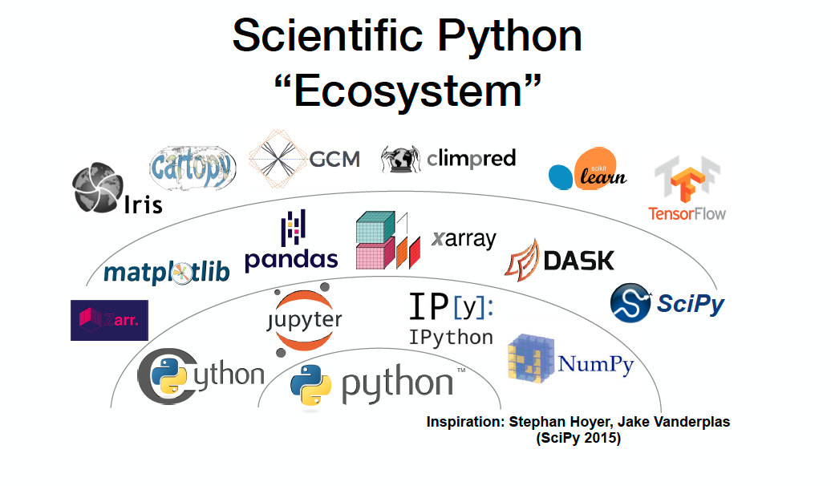

Slide 9
What is “open source”?
Open source is code that is made freely available for possible modification and redistribution via a suitable software license.
The core Python language and its many packages in the scientific ecosystem are all open source
Many open source projects practice:
open development, a transparent way of producing software that involves contributors and users interacting publicly
Peer production, relying on self-organizing communities of individuals

Slide 10
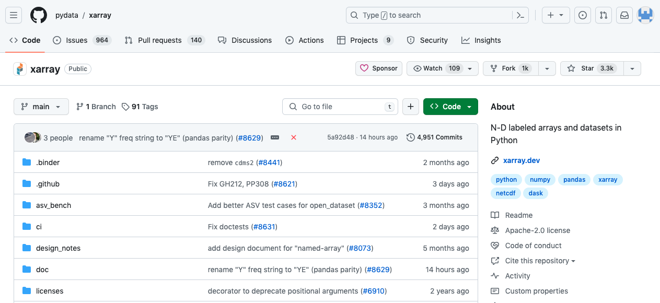
Github provides a platform for version control and sharing projects
Notes:
A pull request is a proposal to merge a set of changes from one branch into another. In a pull request, collaborators can review and discuss the proposed set of changes before they integrate the changes into the main codebase. Pull requests display the differences, or diffs, between the content in the source branch and the content in the target branch.

Slide 11
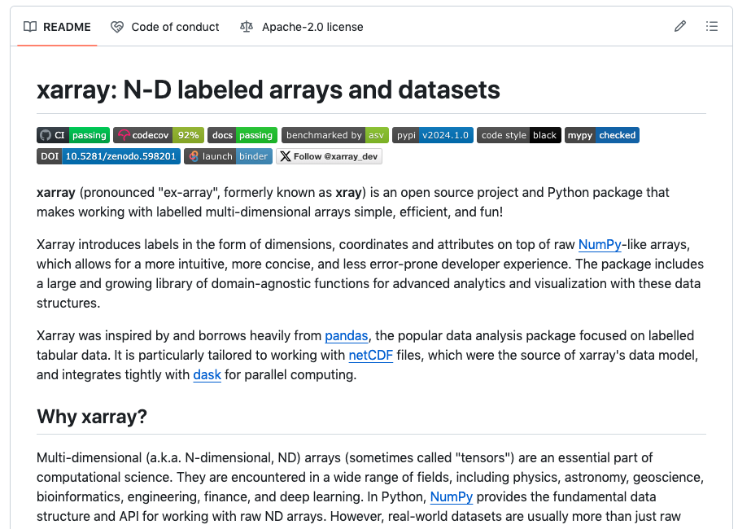
Github readme
Notes:
Badges: Continuous integration: passing means the code that has been tested passes
Codecov: percentage of code that has been tested. Less than 100% means there’s a chance for bugs in the untested code
Bencharked by airspeed velocity – tests how efficient the code is and how fast it should run
Binder: turn your github repository into a bunch of jupyter notebooks
It is the first file a person will see when they encounter your project, so it should be fairly brief but detailed.
It will make your project standout from a bunch of others. Also be sure your project is good too.
It will help you focus on what your project needs to deliver and how.
It will improve your writing skill

Slide 12
Open-science best practices
Encourage all scientists to become responsible participants in the open source ecosystem
Contribute to “upstream” tools on which their research relies (not just code, but bug reports, docs, examples, tutorials, etc.)
Empower all scientists as data/software engineers
Learn best practices for sharing, testing, documenting, and collaborating on research software
Use these practices to transform how we share knowledge

Slide 13
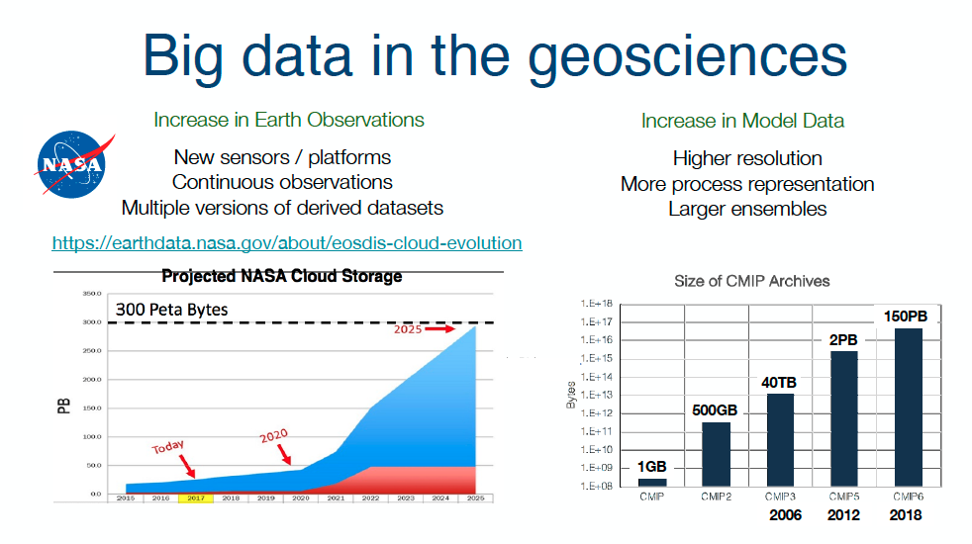
Solution: high performance computing (HPC)
Notes:
Machine learning?

Slide 14
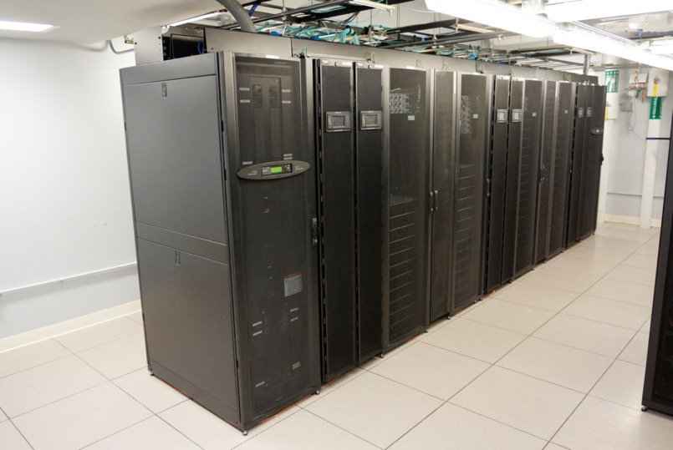
High performance computing
Research problems that use computing can outgrow the desktop or laptop computer where they started.
HPC to the rescue!
A High Performance Computing cluster or supercomputer consists of many compute servers that are networked together.
Each server is called a node.
The nodes in each cluster work in parallel with each other, boosting processing speed to deliver high-performance computing.

Slide 15

HPC in this class
We will be using a LDEO-based HPC called “chopin”
Purchased in 2017, used for research for ~6 years
32 CPUs, 3.2 GHz
256 GB memory per CPU
Gigabit ethernet connection
Ubuntu 22.04
JupyterHub
A unified coding environment

Slide 16
What is “big data”?
“Big data” are data that can be described by the four Vs:
volume – the datasets are large
variety – the datasets may have different formats or types of data
velocity – the data arrive quickly
veracity – there may be uncertainty about the quality of the data or its availability

Slide 17
Big data example: Sep 2019 – Jan 2020 wildfires in Australia
NASA worldview: ~1.2 PB (10¹⁵) per year
https://worldview.earthdata.nasa.gov/

Slide 18
Important links
Class jupyterhub
https://chopin.ldeo.columbia.edu:8441/jupyterhub/
Log in with your username and password (these will be sent to you this week)
Courseworks
https://courseworks2.columbia.edu/courses/207974

Slide 19
Gaining access to the jupyterhub
Look for an email from Dr. Gus Correa with your “chopin” username/password
Change your password to something unique and strong immediately!
10 GB home directory
50 GB data directory
You need to be on the Columbia (or LDEO) network or VPN to connect

Slide 20
Learning goals
Use Linux/Unix commands to work with files and directories
Navigate the JupyterLab Environment effectively
Identify common geoscience data formats and the Python packages which can load them
Perform basic exploratory data analysis on Earth and Environmental data, distinguishing between
Tabular data: rows and columns
Gridded data: multidimensional numerical arrays
Use visualization to enhance interpretation of data, including maps and interactive visualizations
Construct complete, well-structured programs in Python
Practice collaborative, reproducible research through version control and GitHub

Slide 21
Grading
Activity | Weight | Due Date
Attendance and Participation | 10% | Each week
Assignments | 40% | Approx. every week
Final Project | 50% | End of semester
Assignment grading rubric
Total: 100
All answers complete: 50
All answers correct: 25
Answers demonstrate effective use of the concepts taught in class: 25
Notes:
(e.g., if there are 5 questions, each questions has 10 points for completeness, 5 points for correctness, 5 points for “effective use”)

Slide 22
A note on LLMs
We disallow the use of LLMs (e.g. ChatGPT, Claude, Google Gemini) for assignments and final projects in this course.
Why?
They are often wrong
They will often give code that runs but results in nonsensical answers
Your work in this class must be your own, not another person’s or an AI tool’s
We are here to learn and think critically, not become AI “whisperers” or prompt engineers
It is disrespectful to the professor and the TAs, as it is a waste of our time to read/evaluate work that was generated by AI

Slide 23
Assignments
There will be approximately 10-11 assignments throughout the semester.
Assignments are due by 11:59pm on Tuesdays.
Assignments will be posted on Courseworks.
To turn in assignments, you will simply push your code/notebooks to an assignments repository on your github, and you will make the professor (Github: dmw2166) and Tas collaborators so we can check your work.
You can keep pushing changes to your assignments up through the deadline. We will grade the last push before the deadline.
Late assignment policy: Each student will have up to 5 total days of “no questions asked” extensions that they may use on any assignment. No need to ask for permission, but when you have turned in the late assignment, you must email the instructor with the words “Late Assignment Submission” in the subject line to inform them of your submission
Otherwise, 10% deduction per 24 hours (not including weekends)
Medical/family emergencies will of course be accommodated beyond the 5-day allotment

Slide 24
Final project
A project that uses several concepts covered in this course to carry out an extensive data analysis / visualization task
Encouraged to use open data
You will present briefly and demo your final project at the last week of classes
Pick a dataset, and use this dataset to investigate a scientific question or hypothesis. You will use the coding skills to create figures (in a Jupyter notebook) that provides insight regarding the scientific question or hypothesis. There will also be a 5-minute presentation on the project. Students are welcome to use datasets related to their research projects, internships, private industry jobs, etc. (as long as it is climate-related, broadly defined)

Slide 25
Bring your laptop to class
The best way to learn how to code is to start coding, so bring your laptop to class so you can be practicing the various coding commands while we present them.
You will also need your laptop to work on the assignments during the in-class activity times.

Slide 26

Assignment 0
Gain access to the class jupyterhub
Create a github account, email us your github username, create an “assignments” repo, and add the instructor (dmw2166) and TAs as collaborator
https://education.github.com/pack
https://docs.github.com/en/account-and-profile/setting-up-and-managing-your-personal-account-on-github/managing-access-to-your-personal-repositories/inviting-collaborators-to-a-personal-repository

